Slide 1
Life Cycle Models & Principles
Data Services
ICPSR – Summer 2012
Jake Carlson
Data Services Specialist
Purdue University Libraries

Slide 2
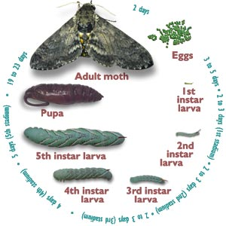
What is a Lifecycle?
The continuous sequence of changes undergone by an organism from one primary form, as a gamete, to the development of the same form again.
http://www.dictionary.com
Graphic: http://insected.arizona.edu/manduca/Mand_cycle.html
Notes:
Use the graphic to discuss the idea behind a lifecycle – depicts change & evolution of an organism and illustrates the process by which that change takes place. Biology is a common subject in which life cycles are used. Here we are exchanging “organism” for “digital objects” or “data”

Slide 3
Types of Lifecycle Models
Subject
Scholarly Communication
Research
Data
Curation
Source
Community
Organizational
Individual
Notes:
The four types of models that we will be discussing today.

Slide 4
Why Use Life Cycle Models?
Helps define and explain complex processes (graphically).
Help to identify important components, roles, responsibilities, milestones, etc.
Demonstrate connections and relationships between parts and the whole.
Provide a framework to develop services and support.

Slide 5
Scholarly Communication Lifecycles
Notes:
Walk through this model – meant to illustrate the development of scientific information – should be at least somewhat familiar to the librarians in the audience.
Show elements of the research process (right side of the circle) and dissemination/publishing process (left side of the circle) through the lens of the information resources that are produced.
Actions and outputs (estimated time).
SDI = Selective dissemination of Information = Current awareness services that are/were offered by libraries.

Slide 6
Scholarly Communication Lifecycles
http://www.gettysburg.edu/library/research/guides/scientific_information/index.dot
Notes:
An example of using a model to design services – This is a modification of the “evolution of science information” model from the Encyclopedia of Library and Information Science article done by Gettysburg College (College of Wooster). “Primary”, “Secondary” and “Tertiary” are all linked text that take the user to a screen that describes each resource types and gives guidance as to how someone would access the resource type.
This diagram and supporting text have been adapted from "Evolution of Scientific Information." [From Allan Kent and Harold Lancour, eds., Encyclopedia of Library and Information Science (New York, 1979), s.v. "Scientific Literature," by K. Subramanyam, 394. Available at http://library.wooster.edu/sciref/Tutor/EvSciInfo/evsciinfo.php (dead link) Thanks to Timken Science Library, College of Wooster.

Slide 7
Research Lifecycles
Graphic: http://www.lboro.ac.uk/services/library/research/
Notes:
Another Example of Modeling Services to a Lifecycle from Loughborough University.
Connection between research and services
http://www.lboro.ac.uk/services/library/research/
Research support
The University Library prides itself on providing high quality services to support the 'Research that matters' that takes place here at Loughborough. We aim to support researchers at each stage of the research lifecycle: the discovery of new ideas; securing funding to investigate those ideas; undertaking the research experimentation itself, and finally the dissemination of research findings.

Slide 8
Research Lifecycle: Funding
UCLA – Office of Research Admin: http://rpc.research.ucla.edu/Pages/ProposalAwardLifeCycle.aspx

Slide 9
Research Lifecycles: Specialized
Cross-Cultural Surveys
Graphic: http://ccsg.isr.umich.edu/intro.cfm
Notes:
Please cite these Guidelines as follows: Survey Research Center. (2010). Guidelines for Best Practice in Cross-Cultural Surveys. Ann Arbor, MI: Survey Research Center, Institute for Social Research, University of Michigan. Retrieved Month, dd, yyyy, from http://www.ccsg.isr.umich.edu/.

Slide 10
Connecting Research & Data Lifecycles
“How JISC is Helping Researchers”
http://www.jisc.ac.uk/whatwedo/campaigns/res3/jischelp.aspx
Notes:
A diagram used by Joint Information Systems Committee - JISC (UK), a group dedicated to championing the use of digital technology for research, teaching and learning, to inform researchers of its services.

Slide 11
Data Lifecycles
Chuck Humphrey (2006) “e-Science and the lifecycles of Research”
http://datalib.library.ualberta.ca/~humphrey/lifecycle-science060308.doc
Notes:
Point to include: “The gaps between chevrons are the transitions that occur in research as products are finished and passed to the next phase. These transition points in the life cycle are the places most vulnerable to information loss… The life cycle approach makes us more aware of possible information losses in the gaps between stages.“

Slide 12
Data Lifecycle Model for ICPSR
Proposal and Planning
2. Project Start Up
3. Data Collection
4. Data Analysis
5. Preparing Data for
Sharing
6. Deposit
Notes:
Plan – Launch – Collection (Processing) – Analysis – (Finalize) – Prepare for Sharing/Publication – Deposit data into repository (Ingest)

Slide 13
Curation Lifecycle
http://www.dcc.ac.uk/resources/curation-lifecycle-model
Notes:
iDCC Curation Life Cycle
The DCC Curation Lifecycle Model provides a graphical, high level overview of the stages required for successful curation and preservation of data from initial conceptualisation through the iterative curation cycle. The model can be used to plan activities within a specific research project, organisation, or consortium to ensure all necessary stages are undertaken, each in the correct sequence. It is important to note that the description, preservation planning, community watch, and curate and preserve elements of the model should be considered at all stages of activity.

Slide 14
OAIS Reference Model: Preservation
Notes:
OAIS - a means to connect roles and responsibilities – producer, manager, consumer – formalizes this relationship
The “gray box portion” is not meant to be visible to the user (prodcuer, consumer)
Almost represents two lifecycles – over time (preservation) and immediate (access)

Slide 15
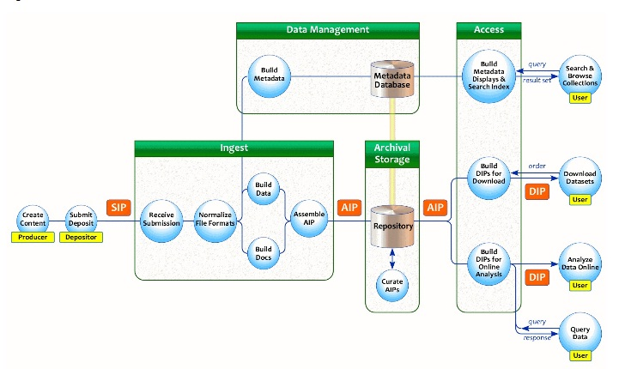
ICPSR Pipeline Process
http://staging.icpsr.umich.edu/icpsralpha/content/datamanagement/lifecycle/oais.html
Notes:
Not a Curation Lifecycle so much as a Curation Workflow for ICPSR – how does this workflow compare with the elements of curation models?
Implementing the Lifecycle Model / Principles in a functional repository.
Adheres to the OAIS Reference Model
Other parts of the Workshop:
- DMP
- Sustainability (SEAD)
- Talking with Stakeholders on DM
Managing disperate data types (video, geospatial, relational databases)
Metadata management and tools
Study level and variable level metadata
Provenance issues
Confidential data management issues
Limiting disclosure risk
Restricted Use Data Contracts and Handling
Digital Preservation
Repository Management – Organization Issues
Repository Management – Technology Issues
Repository Requirements and Assessment – TRAC and Data Seal of Approval
Comparing repository assessment methods
Tracking Reuse
Data Curation Reuse across domains
Next Steps and Follow Up

Slide 16
Applying Lifecycle Models
“All models are wrong, but some are useful”
Models generally reflect the interests, perspectives (and biases) of the agencies that created them.
Models mask complexity.
Models tend to overlook heterogeneity / diversity.
Models are often presented as orderly and linear.
Models depict the ideal.
Notes:
“Since all models are wrong the scientist must be alert to what is importantly wrong. It is inappropriate to be concerned about mice when there are tigers abroad.” – George EP Box in "Science and statistics", Journal of the American Statistical Association 71:791-799
There is no “one size fits all” simple model for this work – if there was we would have found it by now.

Slide 17
A Data Curation Profile contains:
Information about an individual data set, including it’s data lifecycle.
Current management practice.
Unmet needs.
http://datacurationprofiles.org

Slide 18
Individual Data Lifecycles are Unique
Notes:
Each data lifecycle is different – as illustrated by the DCP Data Table. Knowing and understanding these differences is important in managing and curating data sets and in addressing the needs of the researcher. Balance between individual data sets for description, etc. and setting up services that can address general needs.

Slide 19
Individual Data Lifecycles can be Complex
Notes:
Balance between individual data sets for description, etc. and setting up services that can address general needs.

Slide 20
Lifecycle Models & Data Services
Need for developing your organizational model – based on community models and informed by individual lifecycles.
OAIS
Prof.
DCC
Organizational
Model
Prof.
SS Data
Student

Slide 21
Lifecycle Models & Data Services
Need for alignment between data lifecycles and curation lifecycles – informed by research and scholarly communication lifecycles

Slide 22
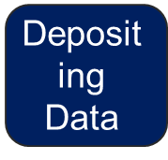
Alignment Between Lifecycles
Data Collection & File Creation
Research
Proposal Development & DMP
Project Start-up
Data Analysis
Preparing Data for Sharing
Ingest
Ingest Storage
Data Mgmt
Archival Storage
Scholarly Communication
Archival
Access Storage
Access
Notes:
Hourglass representing time passing - Hourglass image from: http://www.muhlenberg.edu/depts/psychology/empiricalprimer.htm
This is not meant to represent a complete solution – just convey the need for alignment – there’s still issues surrounding representing / incorporating individual lifecycles.

Slide 23
Questions?
Applied Data Science
ICPSR – Summer 2012
Jake Carlson
Data Services Specialist
Purdue University Libraries

